Slide 1


Presented By: Shivanchal Asthana
Car Price Prediction

Slide 2
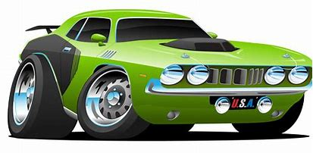
Table of Content
Introduction
Problem Statement
Objectives
Research Methodology
Data Analysis/ Visualizations
Observations
Conversion by using Label Encoder
Multicollinearity
Model Building
CV Score
Plot the Actual and Predicted values
MAE,MSE and RSME
LASSO, RIDGE and XGBoost Regressor.
Gradient Boost Regressor
GridSearchCV By using Gradient Boost Regressor
Saving the model
Predict some values.
Conclusion

Slide 3
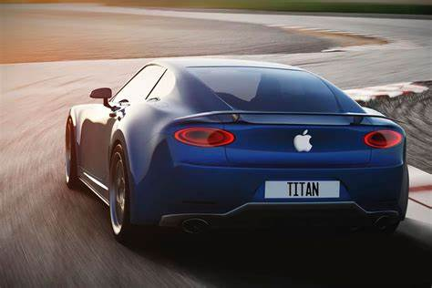
Introduction
Car price prediction especially when the car is used and not coming direct from the factory, is both a critical and important task. With increase in demand for used car, more and more vehicle buyers are finding alternatives of buying new cars outright.
In this project, By using some machine learning model with some new data, We make car price valuation model.

Slide 4
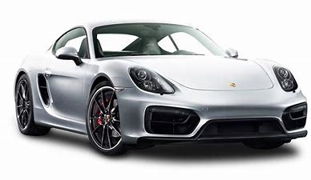
About Problem statement
With the covid 19 impact in the market, we have seen lot of changes in the car market. Now some cars are in demand hence making them costly and some are not in demand hence cheaper. One of our clients works with small traders, who sell used cars. With the change in market due to covid 19 impact, our client is facing problems with their previous car price valuation machine learning models. So, they are looking for new machine learning models from new data. We have to make car price valuation model.

Slide 5
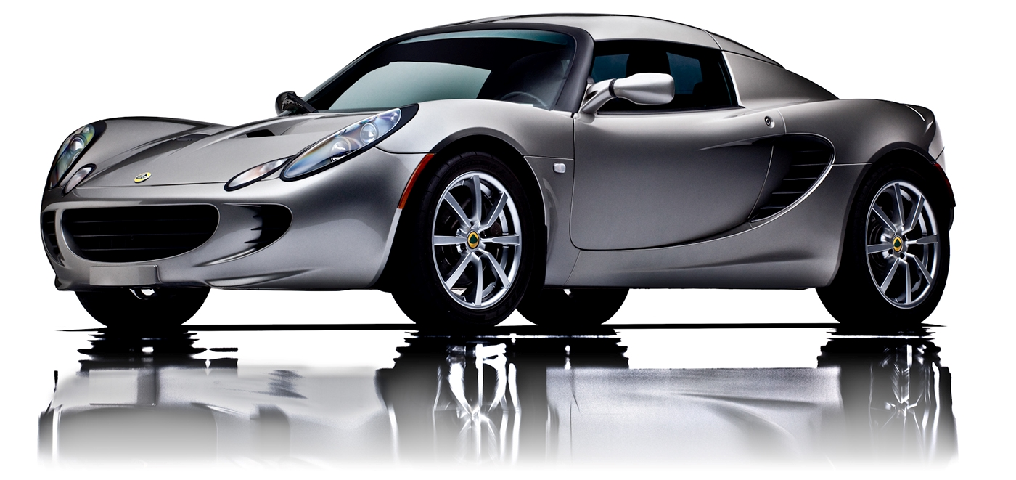
Objectives
The objective in this project is to build a supervised machine learning model that will be accurate, fast trained and fast predicting car value.

Slide 6

Research Methodology
The research methodology adopted for this is given as follows:
Research design: The research design adopted for this study is descriptive research design. The descriptive research design focuses on the accurate description of the variables present in the problem.
Sampling: Sampling allows concentrating upon a relatively smaller number of people and hence, to devote more energy that the information collected from them is accurate.
Sampling Size: The total size of the sample is 6421 respondents.

Slide 7

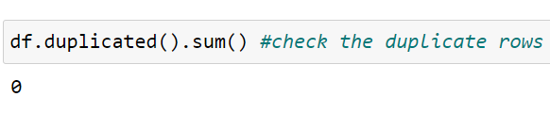
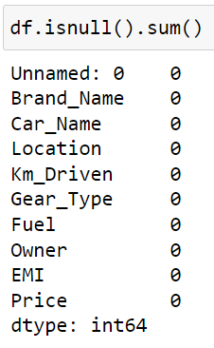
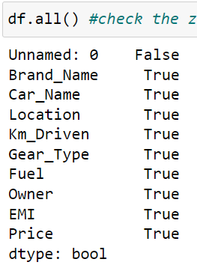
Data Analysis and Interpretation
Observations:
The shape of this dataset is 6421 and column is 10
There is no duplicate values
There are no null values
There are no zero values

Slide 8
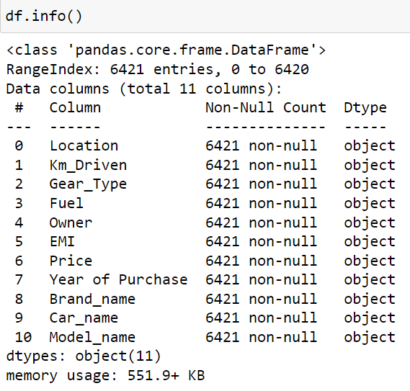
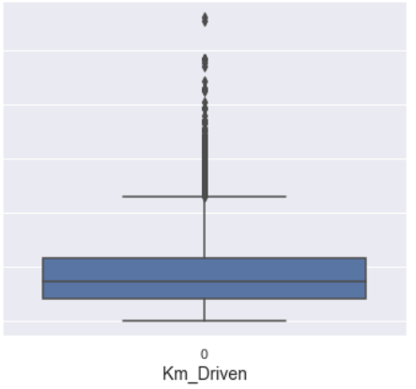
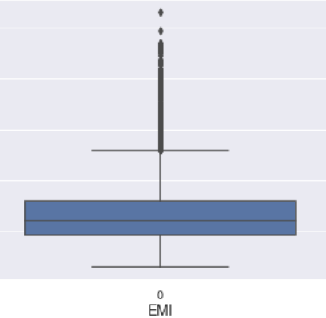
Observations
All columns are in object form initially, but At the end, We convert them into integer or float.
We found some outliers and we treat them by using IQR method.

Slide 9
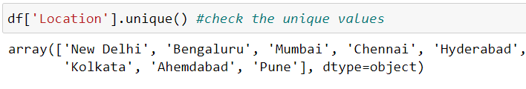
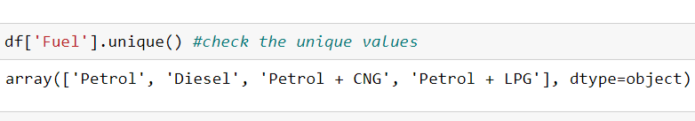
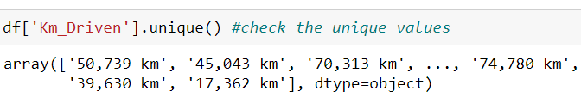
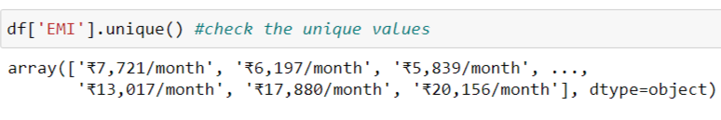
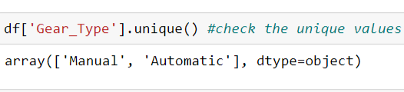

Observations
We can see here, there are 8 cities cars covered in this dataset
There are two types of Gear type: Manual and Automatic
Fuel types are Petrol, Diesel, Petrol + CNG, Petrol + LPG
And there are 4 owners: 1st,2nd,3rd and 4th Owner

Slide 10
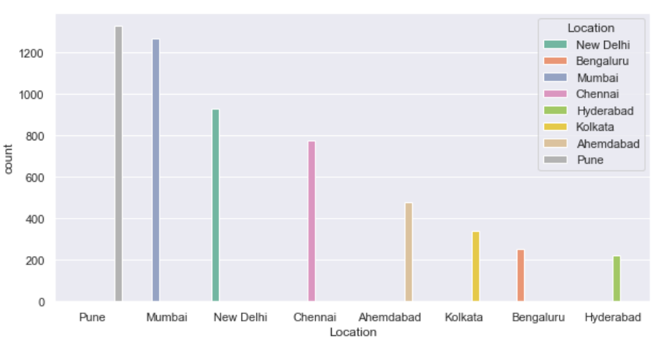
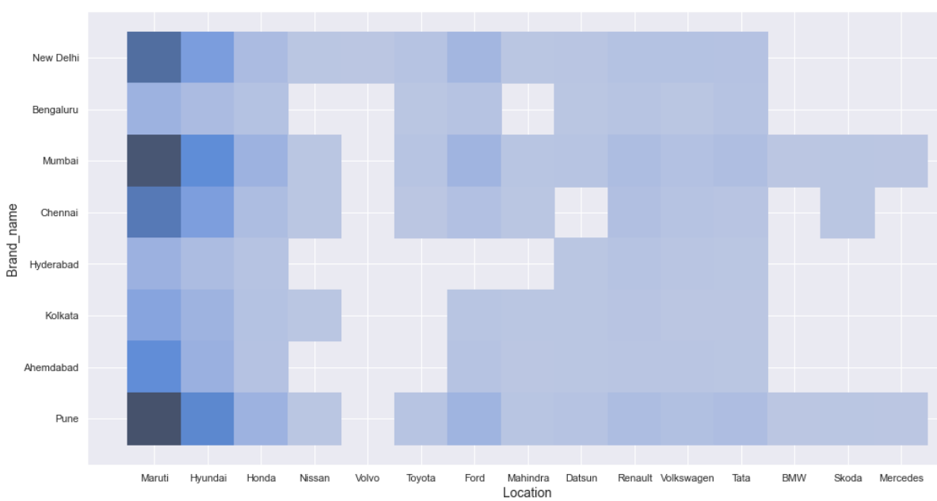
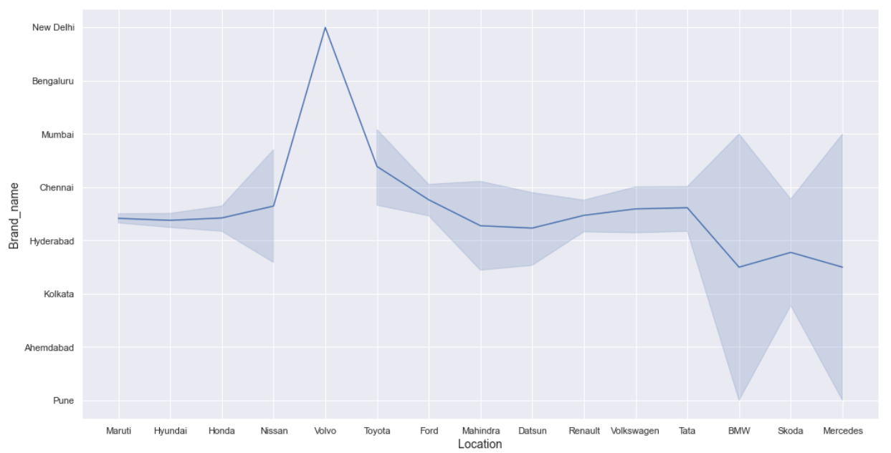
Observations
Pune and Mumbai has more cars in this dataset for prediction.
Hyderabad has least numbers of cars
Volvo is from New Delhi only
By analysing histogram, we can conclude that Maruti is high in numbers and it is mainly from New Delhi, Pune and Mumbai.
BMW and Mercedes is from Pune and Mumbai.

Slide 11
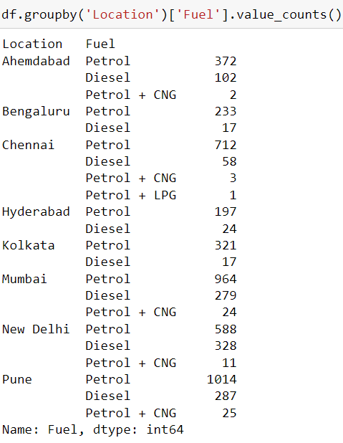
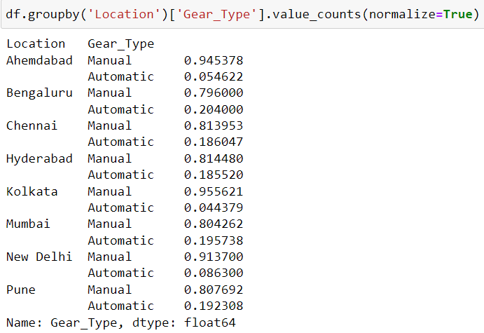
Observations
We can see here, Petrol cars are more in each and every city.
Only one Petrol + LPG car which belongs to Chennai city.
We can see here, Manual cars are more than Automatic.
Bengaluru city has more Automatic cars than Manual

Slide 12
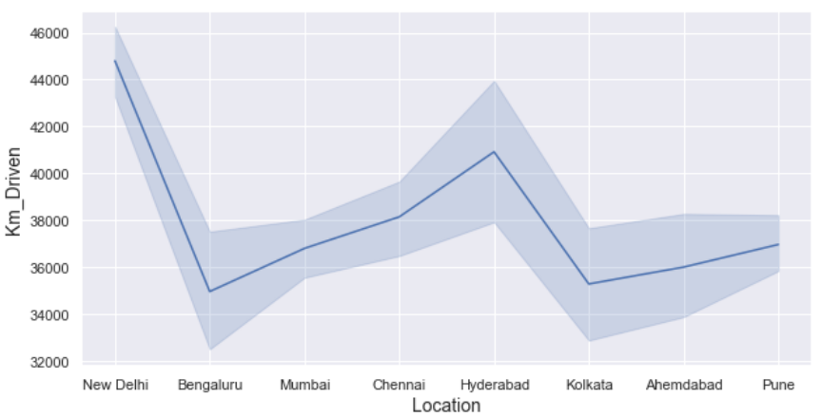
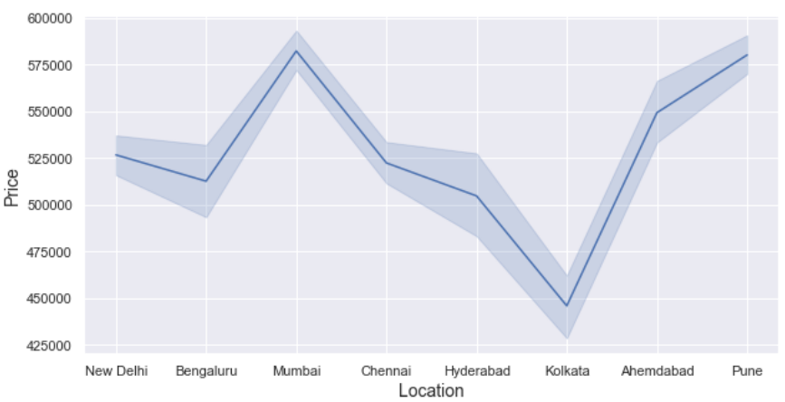
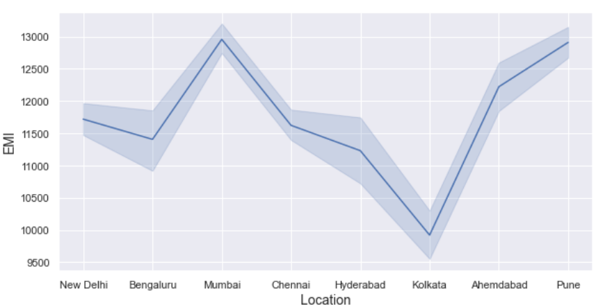
Observations
New Delhi has cars who travels more kilo meters.
Bengaluru has cars who travels less kilo meters.
We can see, In Pune and Mumbai, people have to pay more Emi than other cities.
In Kolkata, people have to pay low Emi than others
Used cars price in Kolkata is less while it is higher in Pune and Mumbai.

Slide 13
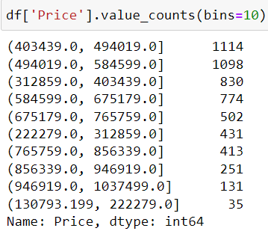
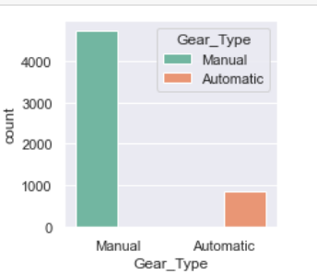
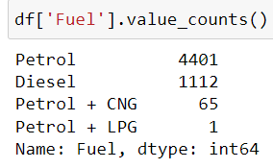
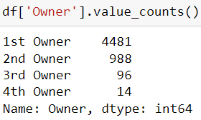
Observations
Around 4 lacs to 5 lacs price of used cars are more in count.
As the price range is increases, Number of used cars are decreasing.
Petrol cars are more than others.
Only one Petrol + LPG used car in this dataset.
Manual used cars are more than Automatic.
1st Owner cars are more than others.

Slide 14
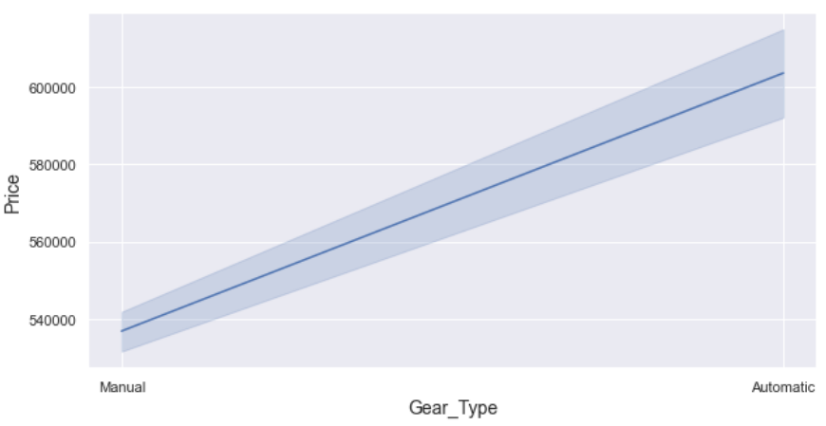
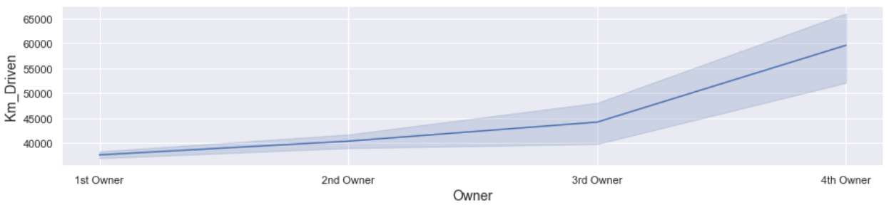
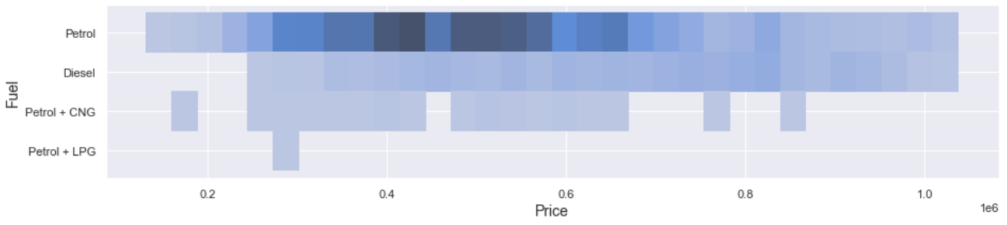
Observations
Price of Automatic used cars are more than Manual used cars.
Price of Petrol used cars are around 4 to 5 lacs
Price of Petrol + LPG used car is around 3 lacs.
As the Ownership increases, Kilo meter driven increases.

Slide 15
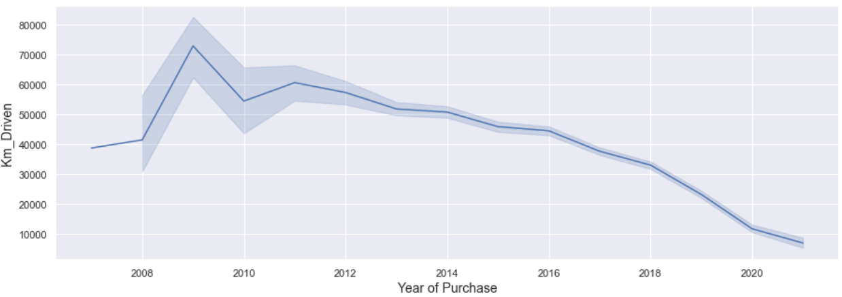
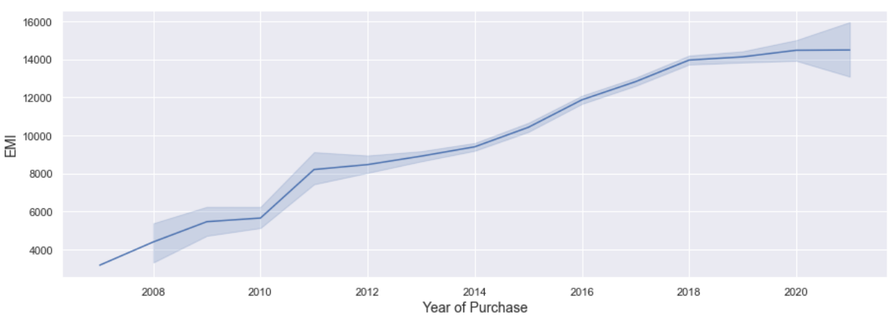
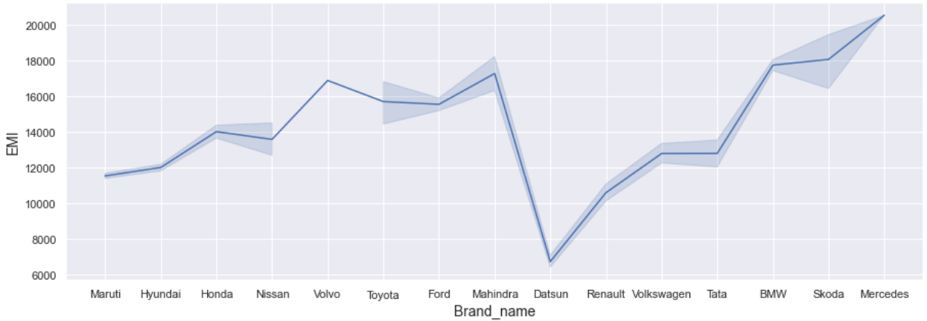
Observations
We can see here, Years of purchase is inversely proportional to each other.
As the car is older, km driven is large.
Mercedes used cars has high EMI than others.
Datsun have low Emi than others.
New cars has high Emi than older one.

Slide 16
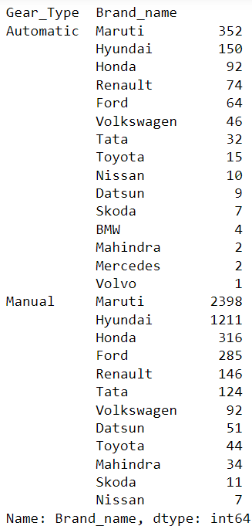
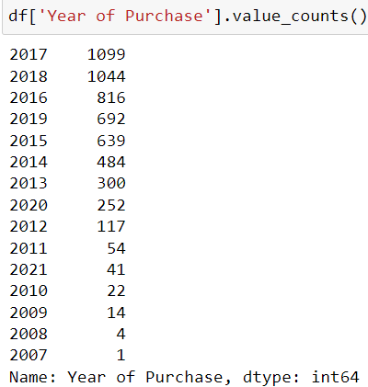
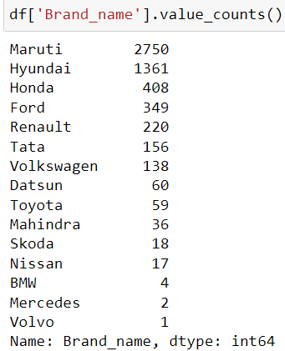
Observations
Maruti used cars are more, both for Manual and Automatic Gear Type.
Volvo is Automatic Type.
2017 is highest for years of purchase of these cars.
Mercedes, BMW and Volvo are least and all are automatic.
Purchased cars are lower in 2007.
Nissan and Skoda are manual cars.

Slide 17
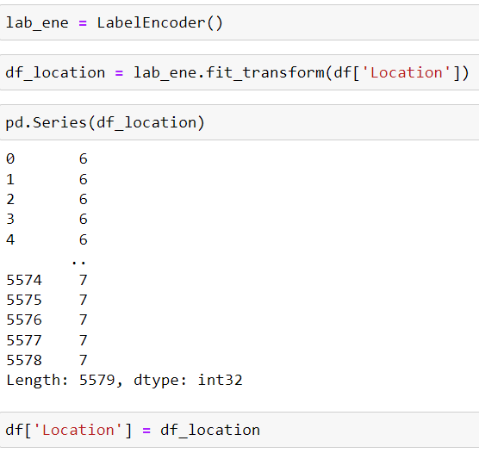
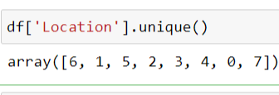
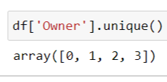


Conversion by using Label Encoder
Observations:
We use Label Encoder to convert object columns into integer.
Gear Type has Manual and Automatic so, It convert 1 for manual and 0 for Automatic.
Fuel has Petrol, Diesel, Petrol + CNG and Petrol + LPG, so, it converts 1 for petrol, 0 for Diesel, 2 for Petrol + CNG and 3 for Petrol + LPG.
Owner has 1st,2nd,3rd and 4th owner. And it converts 0,1,2,3
Locations has major 8 cities of the country and it converts 6 for New Delhi, 1 for Bengaluru, 5 for Mumbai and so on.

Slide 18

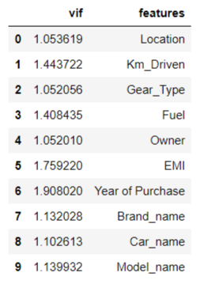
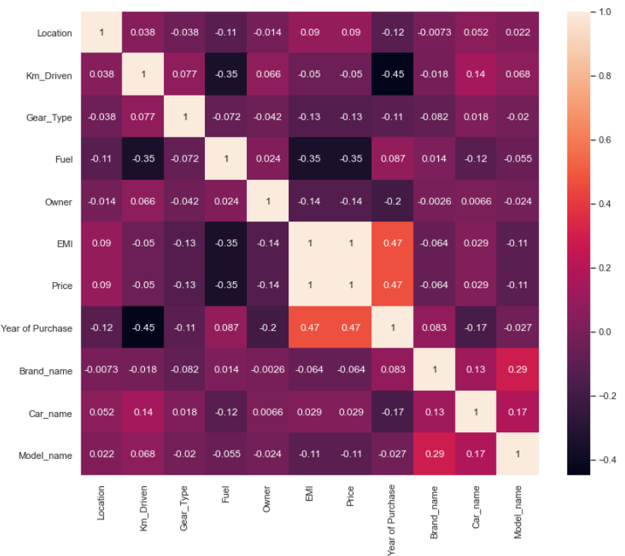
Cleaned dataset saving and Multicollinearity
First we saved our cleaned dataset.
By observing histogram, there is no multicollinearity between independent variables.
There is high multicollinearity between Independent variable (Emi ) and dependent variable (price), which is good for our model accuracy.
By using variance inflation factor, there is no high multicollinearity between independent variables.

Slide 19
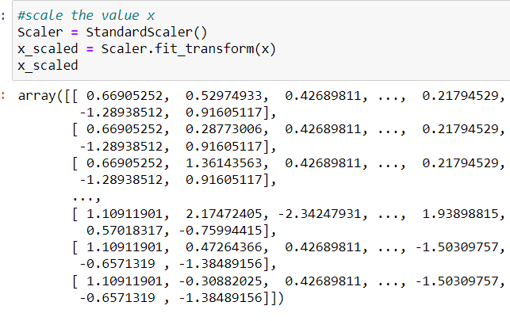
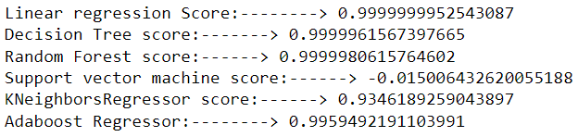
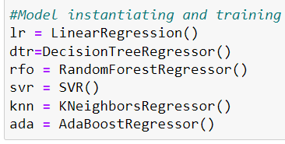
Model Building
Observations:
We use standard scaler to scale the data.
We use, 6 models here to check the accuracy.
We see here, support vector machine is giving us worst accuracy, but Linear regression is giving us best accuracy here.

Slide 20
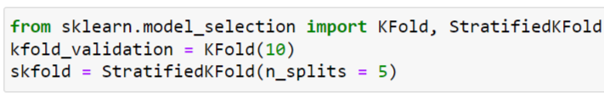
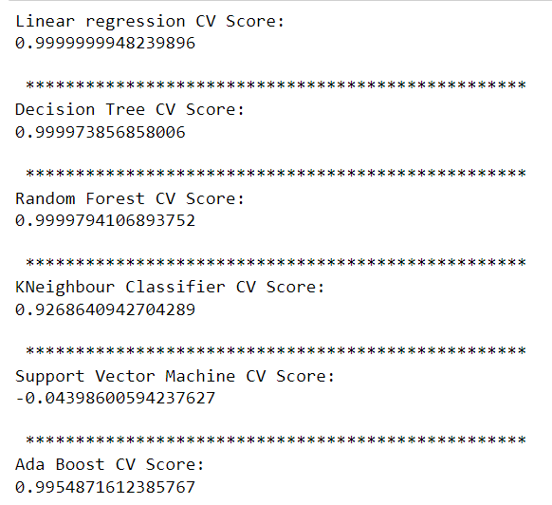
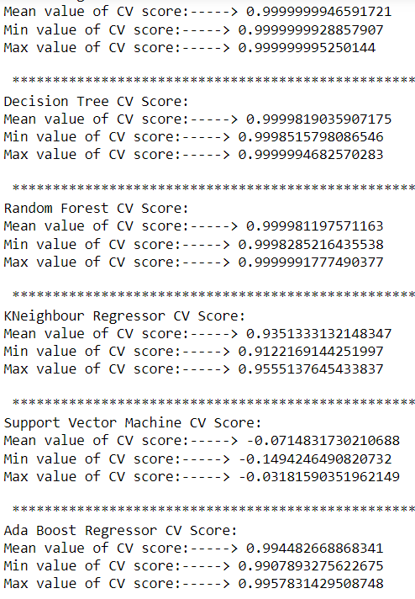
CV Score
Observations:
We use Cross_val_score and kfold cv score.
In kfold cv score, Linear regression is giving good accuracy.
By using cross val score, linear regression is still giving better accuracy than other models

Slide 21
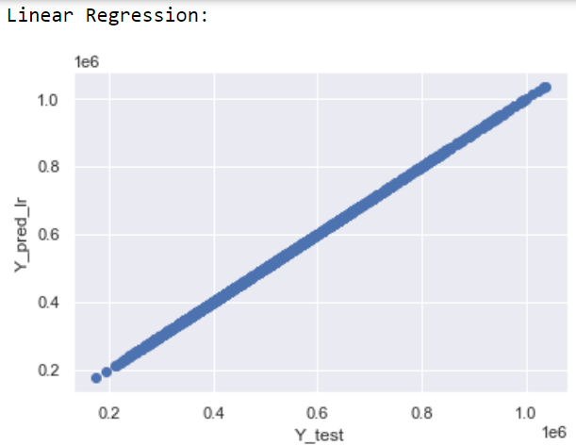
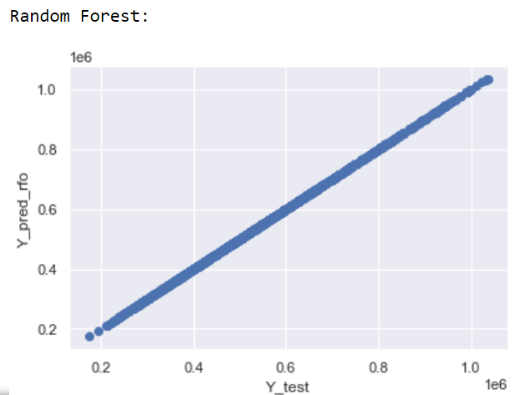
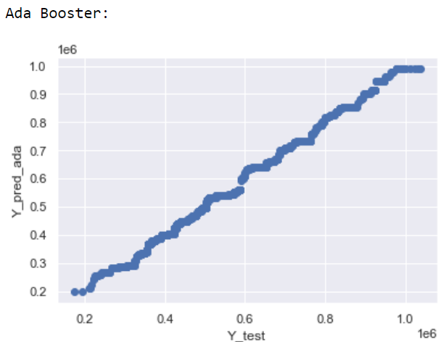

Plot the Actual and Predicted Value
Observations:
We can see here, Linear Regression, Random forest and Decision Tree is giving us linear relationship between Actual and predicted values.
Ada boost regressor is also giving us good relationship but not better than other models.

Slide 22

Model Evaluation : MAE, MSE and RSME
Observations:
Linear regression is giving less values in MAE, MSE and RSME than other.
Support vector machine is giving us worst values as it is mainly used for classification problems.
Decision Trees and Random Forest are also giving us 99% accuracy but still they are giving us high values in MSE, MAE and RSME

Slide 23



Lasso, Ridge and XG Boost Regressor
Observations:
Lasso Regression is giving us 99% accuracy
Ridge Regression is also giving us 99% accuracy
XG Boost Regressor is also giving us 99% accuracy.

Slide 24


Gradient Boost Regressor and GridSearchCV
Observations:
GradientBoostRegressor is also giving us 99% accuracy.
Using Gridsearch cv, GradientBoostRegressor as a estimator, is giving us 99% accuracy.
But after gridsearch cv, accuracy is slightly more than GradientBoostRegressor.

Slide 25


Saving the Model and Predicting the values
We see, Linear Regression is our best model.
By predicting some values, we can check our model is predicting right or not.

Slide 26
Conclusion
We have used regression analysis and have predicted the selling price of the car based on various features of the cars, including the Location, Brand name, car name, kilo meter driven. Emi, fuel, owner of the cars.

Slide 27



More questions about PowerPoint?
Select the Tell Me button and type what you want to know.
Visit the PowerPoint team blog
Go to free PowerPoint training
SELECT THE ARROW WHEN IN SLIDE SHOW MODE

